Slide 1
Bhavani’s Data Visualization Project KPI Dashboard for a hospitality client

Slide 2
Business objective
AtliQ is a company that owns multiple hotel chains across various cities of India
The Managing director / CEO of AtliQ wants to incorporate ‘Business and Data Intelligence’ to identify and track the source of revenue for AtliQ hotels
Hence, it is decided to develop a KPI Dashboard for AtliQ, using May-22 to July-22 data, which can help track its revenue sources and other relevant KPIs across various dimensions
It’ll help the management take strategic business decisions based on the insights generated from the dashboard

Slide 3
Project scope
Identify the data sources pertaining to revenue management
Clean and model the data as per requirement for analysis
Create a revenue dashboard that measures important KPIs
Relevant filters need to provided to slice and dice the data
The dashboard should depict both high level and granular insights

Slide 4
Approach for Solution
There are 5 tables provided for tracking revenue, 3 dimension tables (date, hotel, room) and 2 fact tables (bookings, aggregated bookings)
The data was imported, analysed and transformed as per necessity within Power Query
The relationships between the tables were created within Power Pivot
Power BI was the tool used for creating the visualization/dashboard

Slide 5
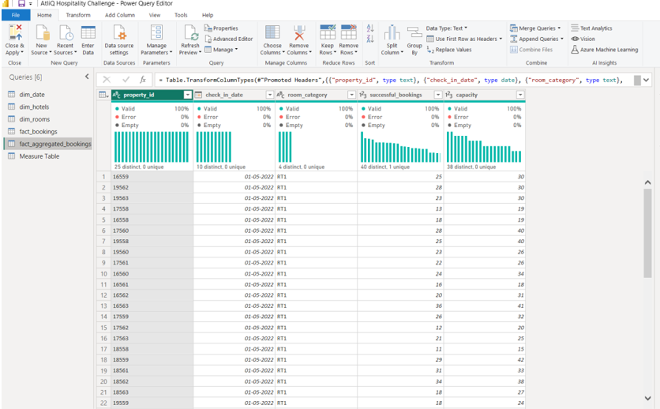
Data Cleaning

Slide 6
Data Modelling

Slide 7
Solution Approach
A few measures were created to calculate the KPIs as shown below:
Revenue = Sum of revenue_realized from Bookings table (in Rs.)
Total bookings = Count of booking_id from Bookings table
Avg rating = Average of Customer ratings from Bookings table
Total capacity = Sum of capacity from Aggregated bookings table
Total successful bookings = Sum of successful bookings from Aggregated bookings table
Occupancy rate = Total successful bookings / Total capacity (in %)
Total cancelled bookings = Count of booking_id with status=‘cancelled’ from Bookings table
Cancellation rate = Total cancelled bookings / Total bookings (in %)
Avg stay duration = Average days stayed by customer in a room per booking

Slide 8
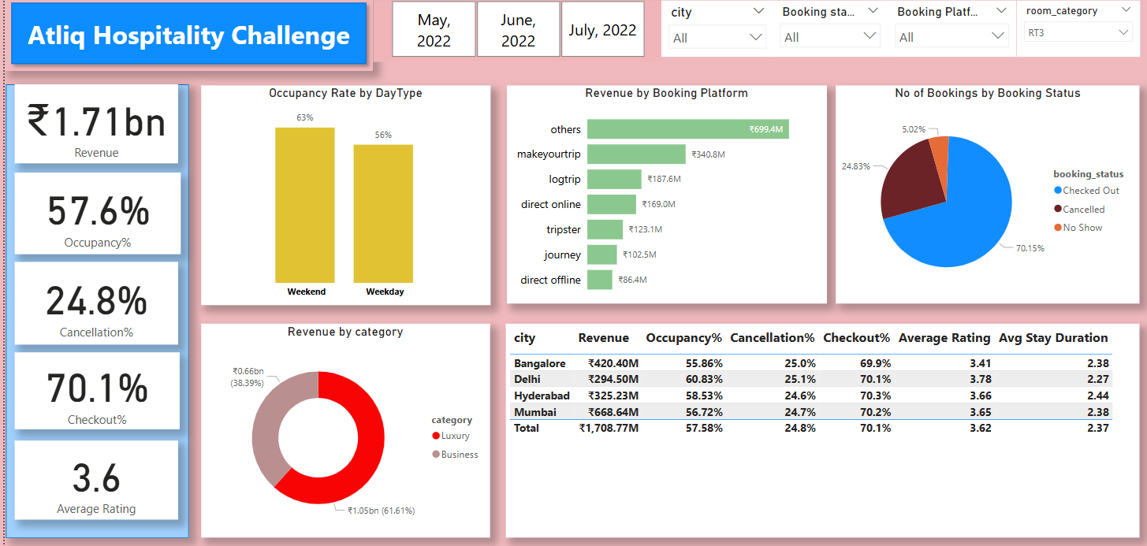
Revenue Dashoboard

Slide 9
Features of the dashboard
The following 5 visuals were provided:
Revenue by platform = Bar chart shows the revenue generated across various booking platforms
Occupancy rate = Column chart shows the percentage of rooms occupied by weekend and weekday
Revenue by room type = Dough nut chart shows the distribution of revenue by room type
Bookings by status = Pie chart shows the distribution of number of bookings based on booking status
KPI table = A matrix visual (pivot table) showing the various KPIs across cities and hotels in each city

Slide 10
Business Outcomes
The following are some important business insights derived from the revenue dashboard:
Mumbai generates highest revenue and Delhi the least revenue during May to Jul 2022. Company need to focus on increasing the revenue in Delhi.
The occupancy rate is higher during weekends across all cities, months and booking platforms. Leverage this insight to increase revenue generated during weekends.
70% of the bookings are checked out while 5% of booking don’t show up across all cities and booking platforms which means 75% of bookings generate revenue for AtliQ hotels. Identify and analyze the reasons for cancellations and try to reduce them.

Slide 11
Business Outcomes
The following are some important business insights derived from the revenue dashboard:Avg rating varies between 3.4 to 3.8 across cities and avg stay duration is 2.4 for each booking. Compare it with the industry benchmark across cities and evaluate the performance.
Occupancy rate is highest at Delhi with 60+ % for all months though generates least revenue compared to other cities. Identify the reason for higher occupancy and use that to drive the revenue growth.

Slide 12
Conclusion
A revenue dashboard was built for AtliQ hotels depicting its various KPIs visually.
Relevant filters along with tooltips and interactions was provided in the dashboard.
This dashboard can be used for both high-level and in-depth analysis of KPIs across various dimensions.

Slide 13
Thank you

